Slide 1
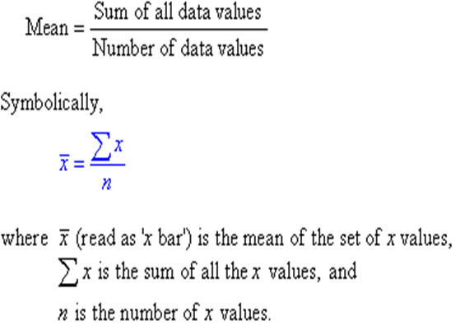
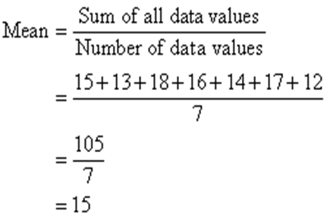
Lecture 5
Dr. Mohammed Abdul Baset
Statistical treatment of analytical data
1. The Mean, the Median and the mode
The mean (or average) of a set of data values is the sum of all of the data values divided by the number of data values. That is:
Example 1:
The marks of seven students in a mathematics test with a maximum possible mark of 20 are given below 15 13 18 16 14 17 12.
Find the mean of this set of data values.
Solution:
So, the mean mark is 15.
Example 2:
Find the mean of these numbers: 3, -7, 5, 13, -2 The sum of these numbers is 3 - 7 + 5 + 13 - 2 = 12 There are 5 numbers.
The median of a set of data values is the middle value of the data set when it has been arranged in ascending order. That is, from the smallest value to the highest value.
24

Slide 2
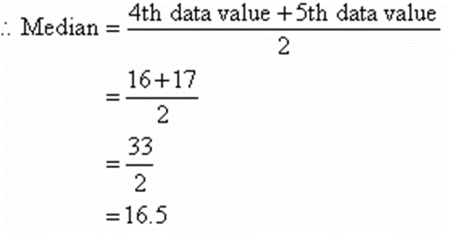
Example 1:
The marks of nine students in a geography test that had a maximum possible mark of 50 are given below: 47 35 37 32 38 39 36 34 35.
Find the median of this set of data values.
Solution:
Arrange the data values in order from the lowest value to the highest value:
32 34 35 35 36 37 38 39 47
The fifth data value, 36, is the middle value in this arrangement.
Median = 36
In general:
If the number of values in the data set is even, then the median is the average of the two middle values.
Example 2:
Find the median of the following data set: 12 18 16 21 10 13 17 19
Solution:
Arrange the data values in order from the lowest value to the highest value: 10 12 13 16 17 18 19 21
The number of values in the data set is 8, which is even. So, the median is the average of the two middle values.
The mode is the data value that appears the most in the set.
Example:
The following is a list of heights (in inches) of a high school basketball team:
67,66,70,74,72,68,71,75,68,72,71 ,68
To determine the mode all we need to do is determine which, if any, of the data values appear the most.
If you look carefully you will see that several of the values appear more than once, but only one of the values appears the most...
25

Slide 3

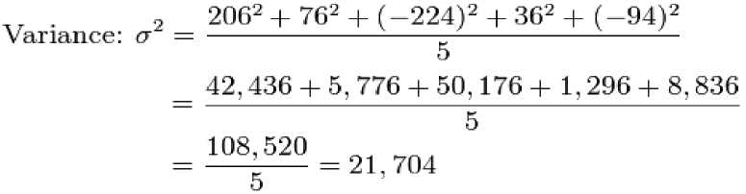
There are 2-71's, and 2-72's, BUT, there are 3-68's!
So, the mode of this set is 68!
5. Precision or accuracy
Precision is how close the measured values are to each other.
Three terms are widely used to describe the precision of a set of replicate data: standard deviation, variance, and coefficient of variation.
The Standard Deviation is a measure of how spread out numbers are.
Its symbol is a (the greek letter sigma)
The formula is easy: it is the square root of the Variance.
The Variance is defined as: The average of the squared differences from the Mean.
Example:
You grow 5 crystals from a solution and measure the length of each crystal in millimeters. Here is your data: 600mm, 470mm, 170mm, 430mm and 300mm.
Find out the Mean, the Variance, and the Standard Deviation?
Solution:
To calculate the Variance, take each difference, square it, and then average the result:
So, the Variance is 21.704.
And the Standard Deviation is just the square root of Variance, so:
Standard Deviation: a = V21.704 = 147.32... = 147 (to the nearest mm)
The coefficient of variation (CV) as a percent is
If the mean is 100 and the standard deviation is 5 then the coefficient of variation is 5%.
26

Slide 4

6. Random and Absolute Error
Absolute error is the amount of physical error in a measurement, period.
(Absolute Error = Actual Value - Measured Value)
The absolute error (E) in the measurement of a quantity x is given by the equation:
where x_{t} is the true or accepted value of the quantity.
Random errors in experimental measurements are caused by unknown and unpredictable changes in the experiment. These changes may occur in the measuring instruments or in the environmental conditions.
7. Relative Error
Relative error gives an indication of how good a measurement is relative to the size of the thing being measured.
To calculate the relative error use the following way:
Observe the true value (x) and approximate measured value (xo). Then find the absolute deviation using formula:
Then substitute the absolute deviation value A x in relative error formula given below:
Absolute deviation Δx = True value - measured value = x - x_{o}
The relative error formula is given by
In terms of percentage it is expressed as
Here A x and x are absolute error and true value of the measurement.
Example:
Student measures the size of metal ball as 3.97 cm but the actual size of it is 4 cm. Calculate the absolute error and relative error.
Solution:
The measured value of metal ball xo = 3.97 cm
The true value of ball x = 4 cm
Absolute error A x = True value - Measured value = X - Xo = 4cm - 3.97cm = 0.03 cm
27

Slide 5
Relative error = 0.0075.
8. Systematic errors
The discrepancy between an accepted value of a parameter and an experimentally measured value results from deviations in the manner in which the measurement is carried out. No two measurements are exactly the same.
28

